Slide 1
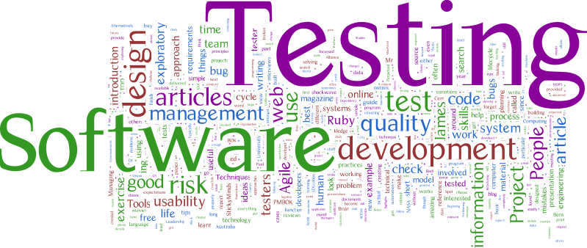
Intro to software testing
What is software testing?
Why is it important?
What are the goals of testing?
When does testing happen?

Slide 2
What is software testing?
Set of activities intended to find bugs within software, as well as validate and verify the software meets the business requirements and needs as designed.
Bug / Defect - an error that causes an incorrect or unintended result

Slide 3
Verification vs validation
Verification
You verify the software is built as the design specification outlined. Ultimately, you are verifying the developer completed the development as it was envisioned.
“Are you building it right?”
Validation
You validate the software that was built solves for the original business problem or fulfills the business need.
“Are you building the right thing?”

Slide 4
Why is It important?
Defects in production systems…
Cost money
Frustrate users
Extend the project
…and in some cases, can cause loss of lives!

Slide 5

Mars climate orbiter
Launched in 1998 to study Mars climate changes
Developer used English units instead of metric
Bug caused it to get too close to Mars atmosphere
Orbiter disintegrated
Net Loss: $327 million dollars

Slide 6

AT&T Long distance
In 1990, 60,000 customers couldn’t make long distance calls
Phones use switches and AT&T has lots to allow for all the traffic
When one switch is full, it passes the traffic to the next switch
Software update was put into production to make the failovers faster
Bug had switches get overloaded, reset, and pass the traffic to the next
AT&T long distance was down for nine hours
Net Loss: $60 million dollars

Slide 7
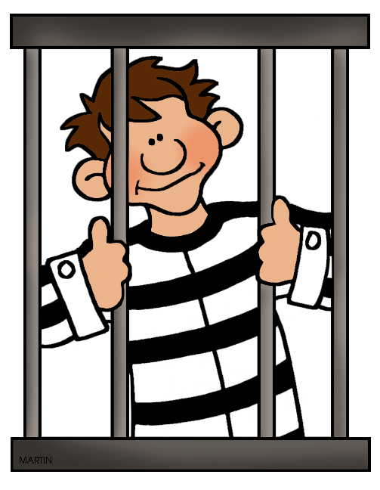
Prisoners released early
Software calculates the sentence based on good/bad behavior
Bug in calculation was introduced in 2002 and not caught until 2015
More than 3,200 prisoners had been released early
Net Loss: Unknown

Slide 8


validation

Slide 9
Goals of testing
Verify the software is built as designed
Show presence of defects
Reduce probability of bugs remaining in software at time of launch
Not to make it bug free (not feasible without large investment)
Validate the software is usable and meets business needs
Confirm intended users can accurately use the software
Ensure the end result solves the original business problem

Slide 10

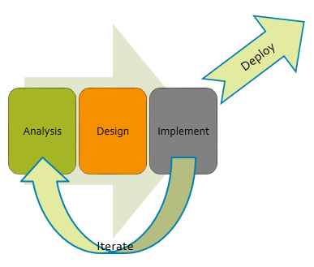





When does it happen?
Waterfall:
Iterative:

Slide 11
Software testing phases
Unit Testing
Integration Testing
System Testing
User Acceptance Testing
Regression Testing
V-Model
Business Requirements
User Acceptance Testing
Functional Requirements
Systems
Testing
Technical Requirements
Integration Testing
Development & Unit Testing

Slide 12
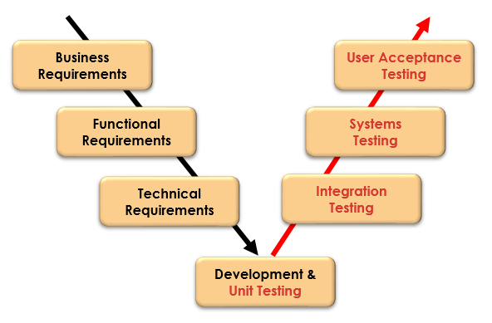
Unit Testing
First step of testing
Completed by developers
Test as each component is completed
Business Analyst’s Role:
Rarely engaged.
If engaged, it is to write test cases and review test results

Slide 13
integration Testing
Pull components together and test as larger unit
Find problems in how components work together
Common place for project failure
Business Analyst’s Role:
Usually engaged if no QA team.
Writes test cases and reviews test results.

Slide 14
System Testing
Last chance for the project team to verify the software
Validate software meets business requirements
Includes many different types of tests
Business Analyst’s Role:
Always engaged.
Write, execute, and analyze test case results.

Slide 15
User acceptance Testing
Final phase of testing
Users utilize real-life scenarios to verify software meets their needs
Users should be the main testers, not the BA
Business Analyst’s Role:
Almost always engaged.
Create scenarios, analyze results, manage defects, and ensure defect resolution.

Slide 16
Regression testing
Performed after initial testing is completed
Retest functions of the software that have not been changed
Ensure changes didn’t “break” previously working functionality
Can be extremely tedious and boring

